Slide 1
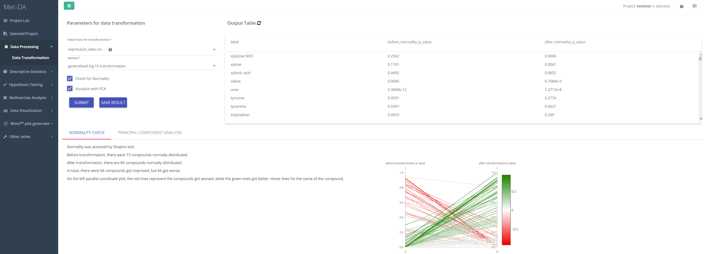
2
1
3

Slide 2
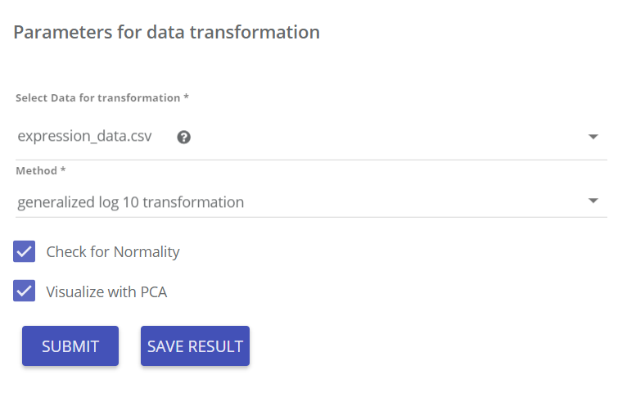
Select data set for transformation
Select Method
Click to check normality before/after transformation. Can be used to help choosing appropriate method.
Click to visualize before/after transformation using Principal Component Analysis. Can be used to help choosing appropriate method.
1

Slide 3
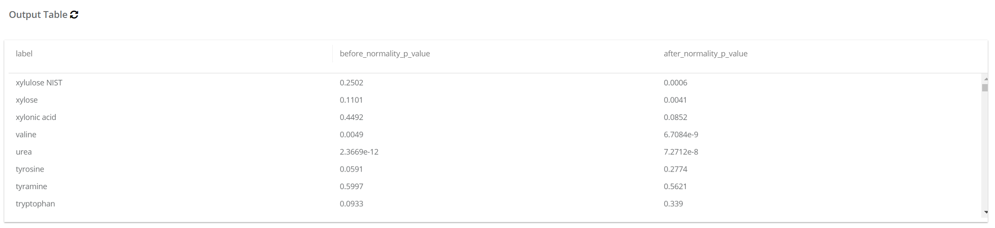
Normality test (Shapiro test) p value before transformation
Normality test (Shapiro test) p value after transformation
A p value less than 0.05 indicates a reject of normality. Usually, the larger the p value, the “more normal” distributed the compound is.
2

Slide 4
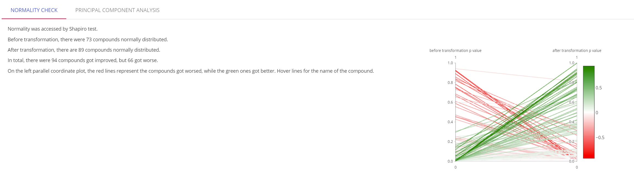
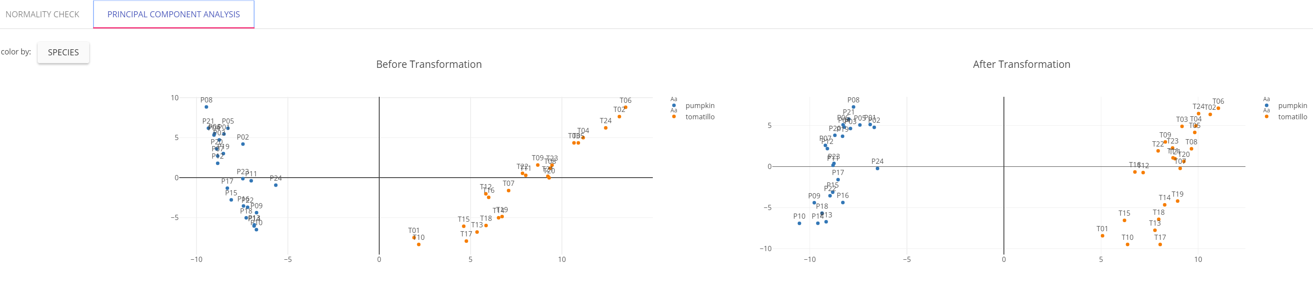
The visualization of Shapiro normality test p value. Greens are compounds got improved.
Summarize the normality before/after transformation.
Got improved means Shapiro normality t test p value got larger.
Visualization of before/after transformation using Principal Component Analysis.
3

